Slide 1
Galaxkey – Workspace - Member
Quick Reference Guide

Slide 2
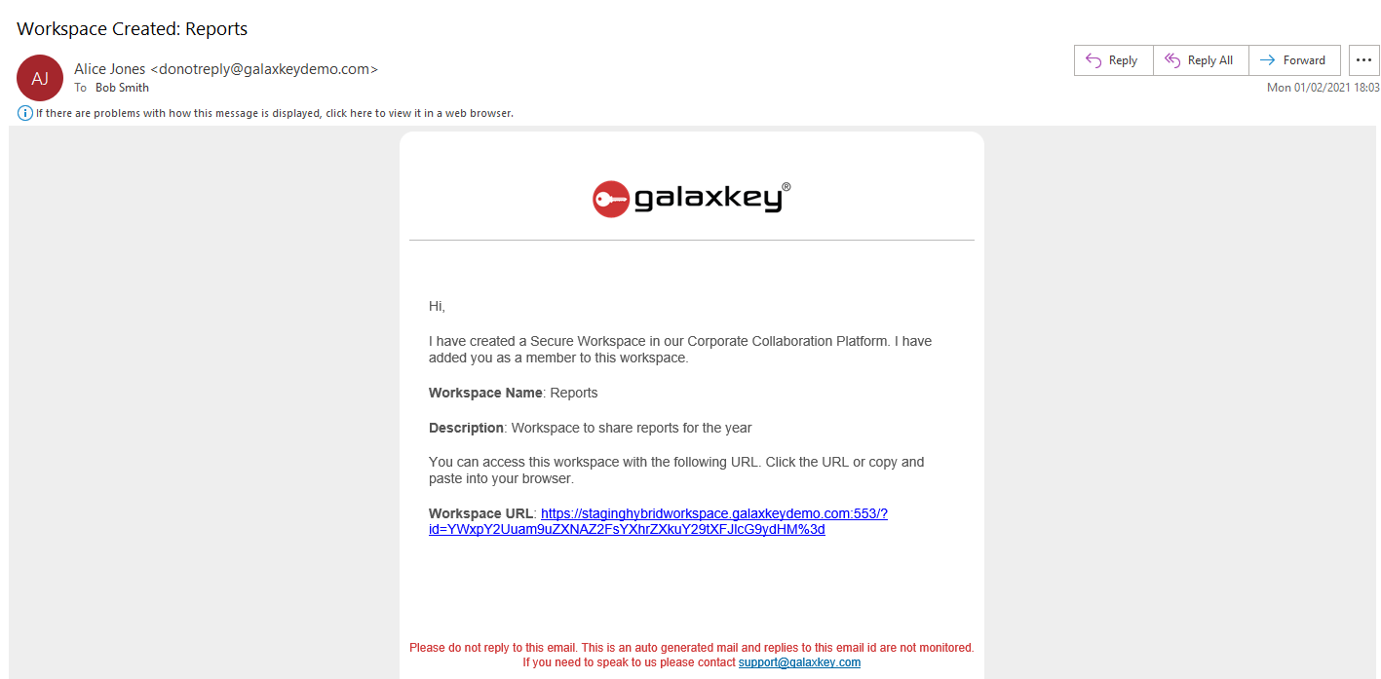
Notification: Why have I received this?
When a Galaxkey registered user wants to exchange file(s) with you, they can do so using Galaxkey Workspaces.
The notification you have received has a link to the workspace
Click this link to access the workspace
Upon logging in, you can
Access files shared with you
Share files with the owner and other members of the workspace
 | You must register with Galaxkey, before you can access the secure workspace. You will be redirected to the registration portal, if you are a new user.

Slide 3
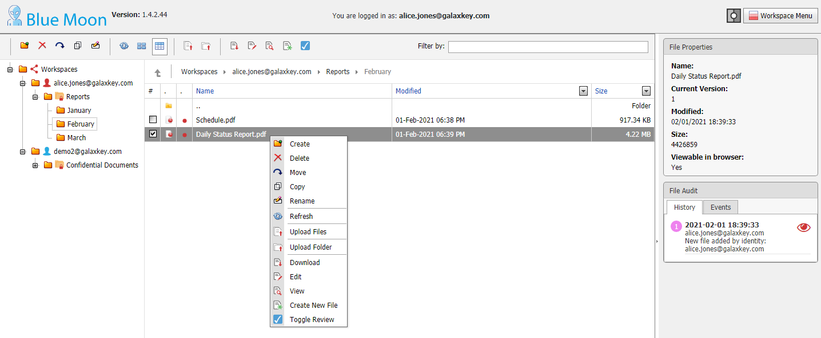
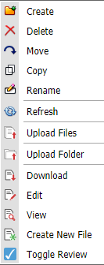
Accessing Files
Files created and uploaded to the workspace are accessible to the members. Thus, based on the access rights granted to each of members, a workspace member can
Delete files
Move Files within and across workspaces
Copy Files within and across workspaces
Rename files
Download files
Edit files
View files
As a member, you can have one or all of these rights

Slide 4
Can I share files in a workspace shared by others
Yes, you can share files in a workspace shared by others. There are two ways of sharing files –
Upload files
Upload folders

Slide 5
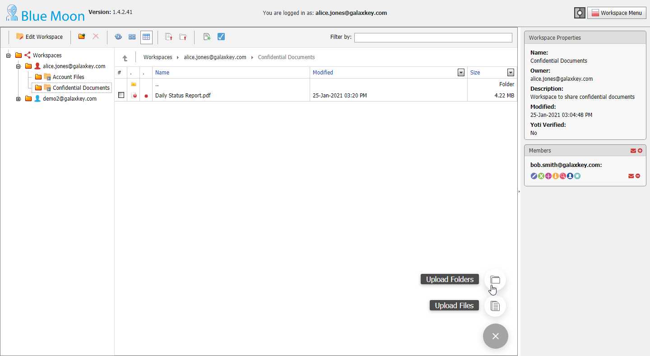
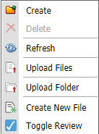
Uploading Files
Click the ‘Upload > Upload files’ button at the right bottom of the page to open the File upload form
Alternatively, click Upload Files menu option from the top menu-bar or the context menu
You can also drag-drop the files in the listing pane of the workspace
You can browse and select or drag-drop the files to be uploaded
On successfully uploading the files, you can choose to send an email to notify the members of the availability of new files
Alternatively, a notification is sent automatically if system notifications option is selected for your workspace
 | The workspace action menu and the properties vary according to the logged in users’ access rights. The owner views all the options, based on the corporate policies.

Slide 6
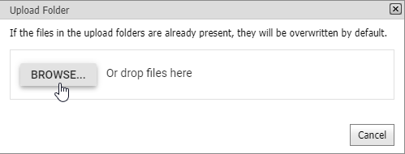
Uploading Folder
Uploading Folder
Click the ‘Upload > Upload folders’ button at the right bottom of the page to open the Folder upload form
Alternatively, click Upload Folders menu option from the top menu-bar or the context menu
You can browse and select or drag-drop the folder to be uploaded
All files in the folder and its sub-folders, if any, are listed and uploaded sequentially
On successfully uploading the folder, you can choose to send an email to notify the members of the availability of new files
Alternatively, a notification is sent automatically if system notifications option is selected for your workspace
 | The workspace action menu and the properties vary according to the logged in users’ access rights. The owner views all the options, based on the corporate policies.

Slide 7
A zip file has been shared with me and I do not have rights to download it

Slide 8
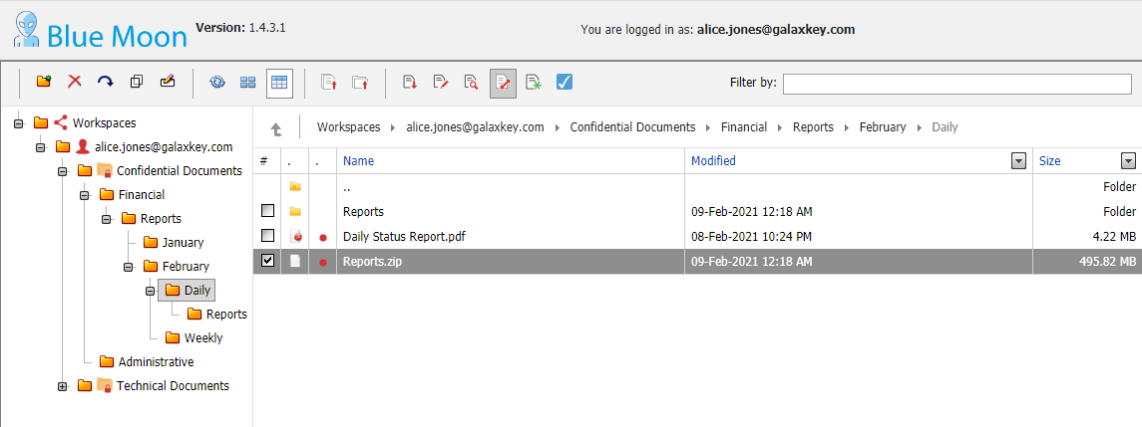
Unzip Files
Unzip Files
You can upload compressed files (.zip) to the workspace
You can extract the contents of such folders online without the need to download.
Select the file to be unzipped and click ‘Unzip’ button in the menu option
A folder is created with the name, same as the zip file
You will receive a status report – Success or Failure, on completion of the process
 | The workspace action menu and the properties vary according to the logged in users’ access rights. The owner views all the options, based on the corporate policies.

Slide 9
Are there any other actions I can perform?
Yes, there are quite a few actions that a member can do, based on the access rights assigned by the workspace owner.

Slide 10
View, Download & Rename files
View Files
Select the file and click the View menu option to view it online in a browser
Double-click the file to open in Edit mode, if you have Write and Add access to a Workspace
You can open the file in view mode if
You do no have edit access to the workspace
Selected file is not editable online using Galaxkey Collaborative features
Download Files
Select the file and click the ‘Download’ menu option to download the file
Rename Files
Select the file and click the Rename menu option to edit the file name
You can rename the files uploaded and created in the workspace

Slide 11
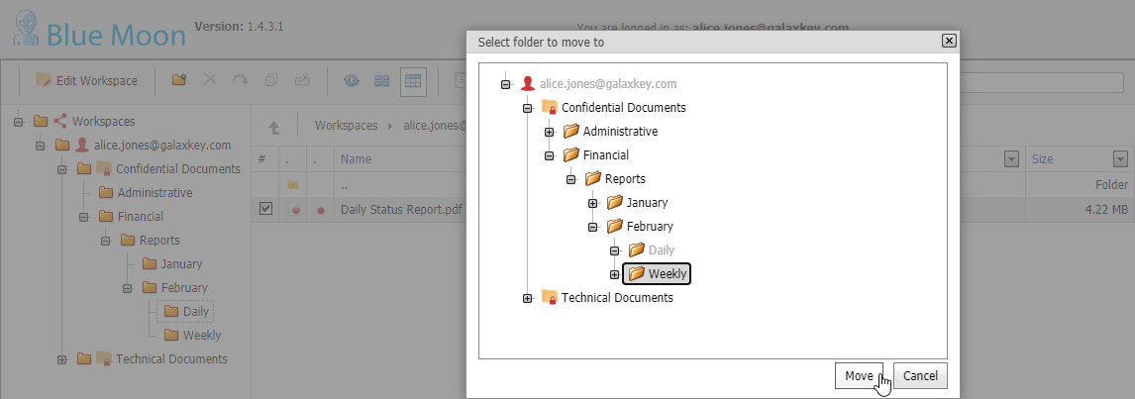
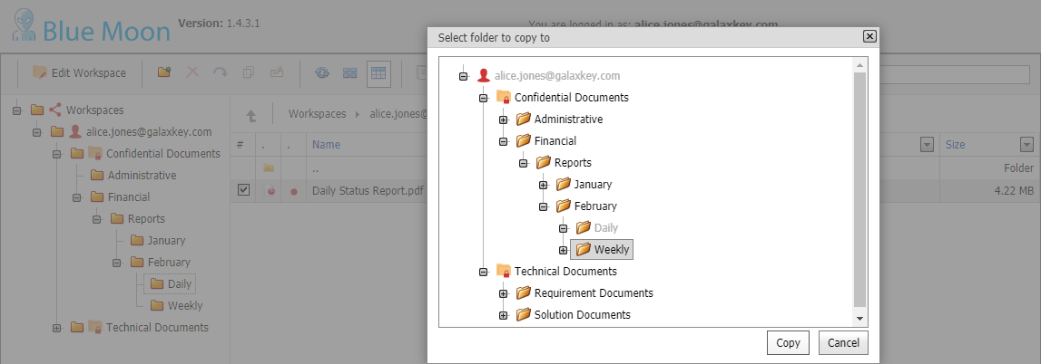
Moving & Copying Files
Moving Files
You can move files from one folder to other within a workspace or across workspaces
Select the file to be moved and click Move button in the menu option
On the folder selection dialog, select the required folder and click OK
Moved files will be deleted from the source folder ONLY IF user has delete access to the source workspace
Copying Files
You can copy files from one folder to other within a workspace or across workspaces
Select the file to be copied and click Copy button in the menu option
On the folder selection dialog, select the required folder and click OK

Slide 12
Some files must be shared by my colleagues who are not members of the workspace

Slide 13
Member Manage Rights
Situations may arise where the current member must grant workspace access to other members of their organization
Such members can add others from their OWN DOMAIN as members, if they have Member Management Rights to the workspace.
Log on and navigate to the workspace
On the right-hand Properties pane, if you can see a ‘+’ sign in the Members section, you can add others to the Workspace
Click on the ‘+’ button.
On the Add New Member dialog, enter the email address and click Add to add the member to the workspace
This new member inherits your access rights except for Manage Members

