Slide 1
Galaxkey – Workspace
Quick Reference Guide

Slide 2
Introduction
Galaxkey Workspace
Secure online file sharing and collaboration platform
Secure and highly configurable by design
Security Features:
User Access Control
Secure Storage of files on server
Geographical restrictions
Configurable Features:
File size limit
File types
Retention policies
Notifications and templates thereof
Additional security features
Auto-versioning of files
GDPR compliant

Slide 3
Workspace: Roles
Configure workspace & Manage access to workspace
Assign files for review – shared by members
Corporate Administrator
Workspace Owner
Reviewer
Owner: Galaxkey registered user who creates workspace.
Member: Galaxkey registered user who can access the workspace. Members can be users from the same corporate, other corporate or individual (free/subscribed)
Reviewer: Galaxkey registered user who can access file marked for review. Reviewers, like members, can be corporate or individual users (free/subscribed)
Administrator: Galaxkey corporate administrator who can manage workspaces across all the domains of the organization.
Create, Share workspace & Manage access to workspace
Functions
Members
Functions
Access files
Share files
Edit files
Copy/Move files
Delete files

Slide 4
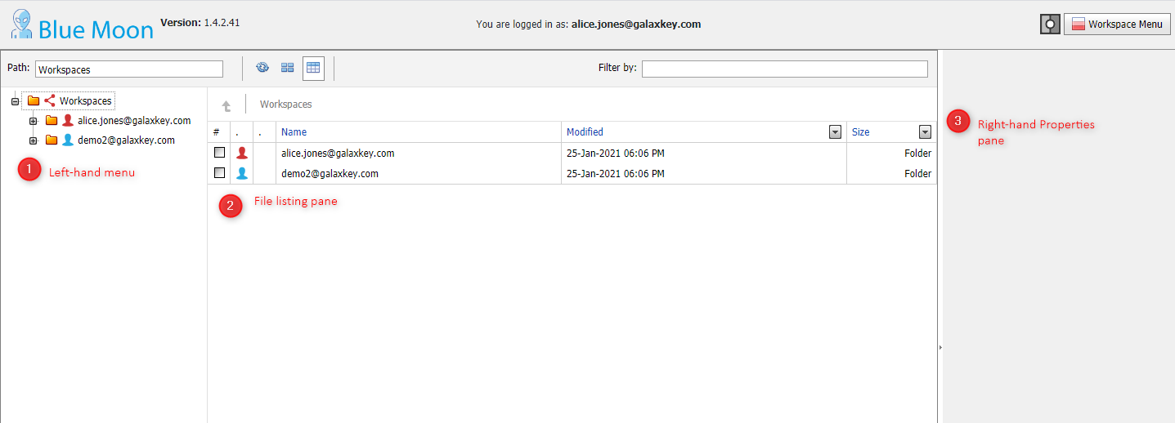
Workspace: Authentication and Listing
Workspace only set-up: Galaxkey will redirect you to the Workspace listing after logon
Workspace and Email set-up:
Log on to the Galaxkey Manager and navigate to Workspace menu
From the list of accessible workspaces, click on appropriate workspace to view the workspace listing
You can see all workspaces accessible to you grouped by the owner of the workspace.
The red icon in the left-hand menu or list is your own identity
To view the workspaces shared with you,
Expand the folder in the left-hand menu OR
Select the owners name to view in right-hand pane
By default, the right-hand pane shows the files and folder in details view. You can change this to the thumbnail view.

Slide 5
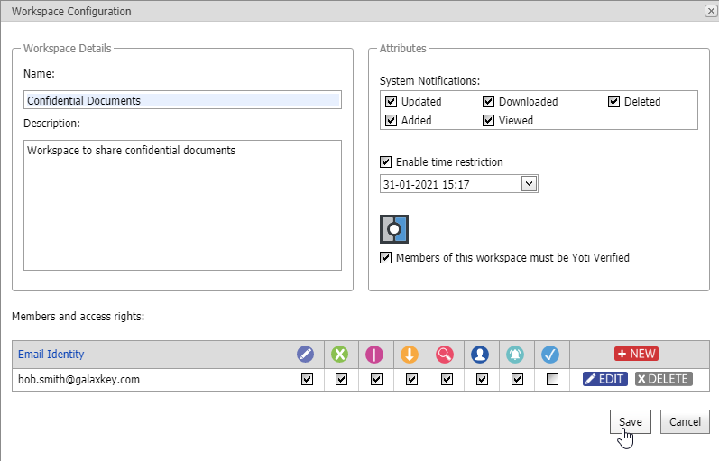
Creating Workspace
The Create Workspace button is enabled on top of the page when you select your identity in the left-hand menu
Click Create Workspace to open the Workspace Configuration form
Enter the Name and Description and click Save to create a workspace
Such workspace is accessible to the owner only and thus, is deemed as private workspace
To create a shared workspace, you must
Add members
Assign attributes
These are explained in detail in the following sections
 | The options available on the Workspace Configuration form vary according to the Corporate Configurations

Slide 6
Creating Workspace: Add Members
Click the New button in the Members and access rights section
This form has four sections
Member Information
File Access Rights
Reviewer Rights
Administrative Rights
The Member Information and File Access rights sections are mandatory
The Reviewer rights and Administrative rights sections are available based on your corporate configurations
Enter the Email ID of a user to be added as the workspace member
From the list of file access rights, select the ones you want to offer to this member
Click Save to add the member.
 | The options available on the Workspace Configuration form vary according to the Corporate Configurations

Slide 7
Add Members: File Access Rights
You can grant following access rights to the members -
Write: Ability to create and edit files
Delete: Ability to delete files
Add: Ability to add or upload files
Download: Ability to download files
View members: Ability to view other workspace members
By default, the Download option is selected
Thus, if you want a member to upload a file and edit it online, you must grant Write and Add access.
If none of the options are selected, the member gets a View access to the files in the workspace
Thus, the member can view the files online in a browser
 | The options available on the Workspace Configuration form vary according to the Corporate Configurations

Slide 8
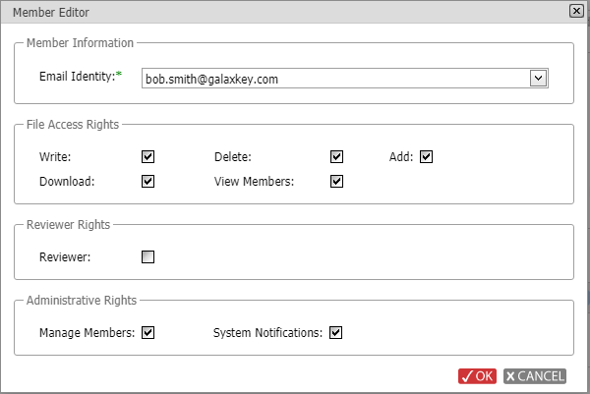
Add Members: Reviewer & Administrative Rights
Reviewer Rights
A member with Reviewer rights can
Gain ‘View Only’ access to a workspace only when at least one file is assigned for review
Access only the files assigned for review
Administrative Rights
Manage Members: Ability add or remove members to workspace from members’ domain
These new members inherit their access rights from the member who adds them
New members DO NOT get manage member rights
System Notifications: Ability for the members to receive system generated notifications on events selected while creating the workspace. These include
Updated
Downloaded
Deleted
Added
Viewed

Slide 9
Creating Workspace: Configure Attributes
System Notifications
Galaxkey sends notification emails to the owner when members of the workspace access the files
Select the events for which you want to other members of the workspace be notified
You can select the System Notifications option for a member if you want members to be notified.
Enable Time restriction
This setting restricts members’ access to the workspace for a set time period.
The members lose access to the workspace after the selected date and time, but the workspace is still accessible to the owner
Yoti Verification
Select the Members of this workspace must be Yoti verified option if you want the members to access the workspace only when verified using Yoti Verify
Create Workspace
Once you have configured attributes and added members, click Save to create the workspace
The new workspace is now available in the list and is ready for secure file sharing

Slide 10
Edit & Delete Workspace
Editing Workspace
You can edit all the options of the workspace except for its name.
In the edit mode, you can
Add new members
Modify access rights of previously added members
Remove members
Modify attributes
Delete Workspace
Based on your corporate policy, you can delete workspaces you own. More details in the following slides

Slide 11
Workspace Properties & Menu
Workspace Properties
The right-hand Workspace Properties pane provides a quick view of the workspace configuration
Based on your access rights, you can also see the members of the workspace and their access rights in addition to other details like last modification date
Workspace Menu
When you expand a workspace, the following menu options visible on the top, help you to take further actions
Edit Workspace: Option to edit workspace configuration
Upload File: Option to upload files from desktop
Upload Folder: Upload folders from desktop
Create Folder: Create folder online
Create File: Create file online
 | The workspace action menu and the properties vary according to the logged in users’ access rights. The owner views all the options, based on the corporate policies.

Slide 12
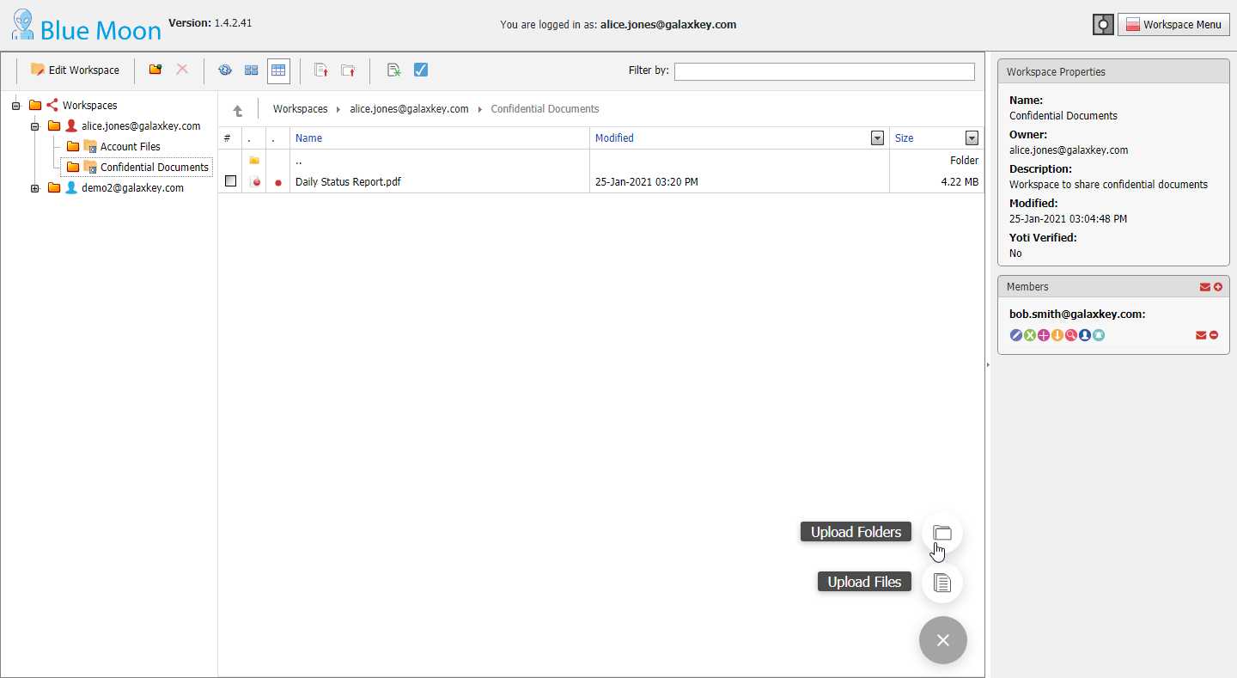
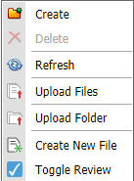
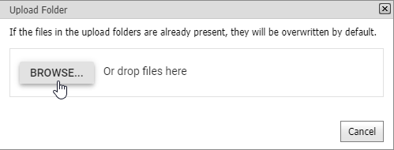
Uploading Folder
Uploading Folder
Click the ‘Upload > Upload folders’ button at the right bottom of the page to open the Folder upload form
Alternatively, click Upload Folders menu option from the top menu-bar or the context menu
You can browse and select or drag-drop the folder to be uploaded
All files in the folder and its sub-folders, if any, are listed and uploaded sequentially
On successfully uploading the folder, you can choose to send an email to notify the members of the availability of new files
Alternatively, a notification is sent automatically if system notifications option is selected for your workspace
 | The workspace action menu and the properties vary according to the logged in users’ access rights. The owner views all the options, based on the corporate policies.

Slide 13
Uploading Files
Click the ‘Upload > Upload files’ button at the right bottom of the page to open the File upload form
Alternatively, click Upload Files menu option from the top menu-bar or the context menu
You can also drag-drop the files in the listing pane of the workspace
You can browse and select or drag-drop the files to be uploaded
On successfully uploading the files, you can choose to send an email to notify the members of the availability of new files
Alternatively, a notification is sent automatically if system notifications option is selected for your workspace
 | The workspace action menu and the properties vary according to the logged in users’ access rights. The owner views all the options, based on the corporate policies.

Slide 14
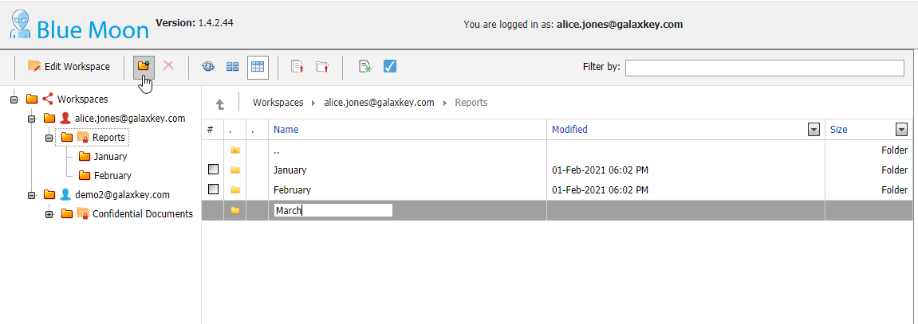
Creating Folder
Folders provide a better organizational structure to a workspace. While you can directly upload a folder and its contents, you can create folders on-the-fly.
Click the Create Folder menu option in the menu or the Context menu
Depending on your cursor position, enter the folder name in the right-hand listing pane or the left-hand menu pane.
Your folder is created, and you can now add files and subfolders to it.
Each workspace can have multiple folders and subfolders
 | The workspace action menu and the properties vary according to the logged in users’ access rights. The owner views all the options, based on the corporate policies.

Slide 15
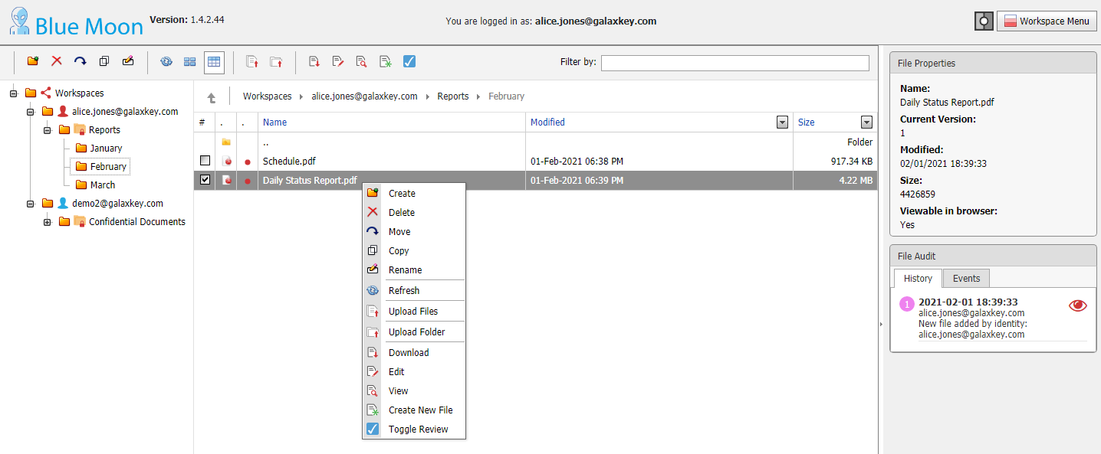
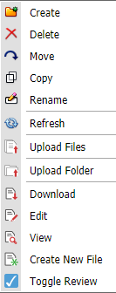
File actions
Files created and uploaded to the workspace are accessible to the members. Thus, based on the access rights granted to each of members, a workspace member can
Delete files
Move Files within and across workspaces
Copy Files within and across workspaces
Rename files
Download files
Edit files
View files
Toggle Review: Workspace owner can submit files for review

Slide 16
File actions: View, Download & Rename files
View Files
Select the file and click the View menu option to view it online in a browser
Double-click the file to open in Edit mode, if you have Write and Add access to a Workspace
You can open the file in view mode if
You do no have edit access to the workspace
Selected file is not editable online using Galaxkey Collaborative features
Download Files
Select the file and click the ‘Download’ menu option to download the file
Rename Files
Select the file and click the Rename menu option to edit the file name
You can rename the files uploaded and created in the workspace

Slide 17
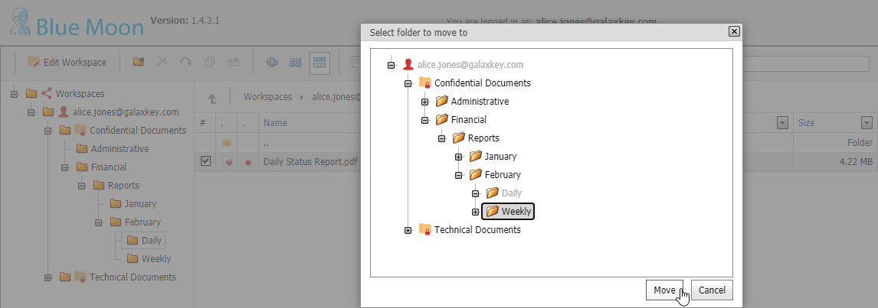
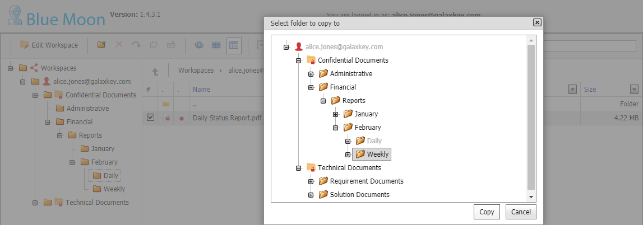
File Actions: Moving & Copying Files
Moving Files
You can move files from one folder to other within a workspace or across workspaces
Select the file to be moved and click Move button in the menu option
On the folder selection dialog, select the required folder and click OK
Moved files will be deleted from the source folder ONLY IF user has delete access to the source workspace
Copying Files
You can copy files from one folder to other within a workspace or across workspaces
Select the file to be copied and click Copy button in the menu option
On the folder selection dialog, select the required folder and click OK

Slide 18
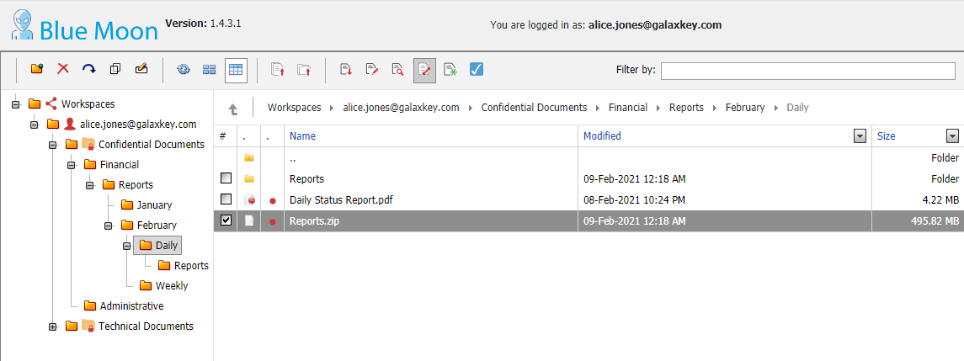
File Actions: Unzip Files
Unzip Files
You can upload compressed files (.zip) to the workspace
You can extract the contents of such folders online without the need to download.
Select the file to be unzipped and click ‘Unzip’ button in the menu option
A folder is created with the name, same as the zip file
You will receive a status report – Success or Failure, on completion of the process
 | The workspace action menu and the properties vary according to the logged in users’ access rights. The owner views all the options, based on the corporate policies.

Slide 19
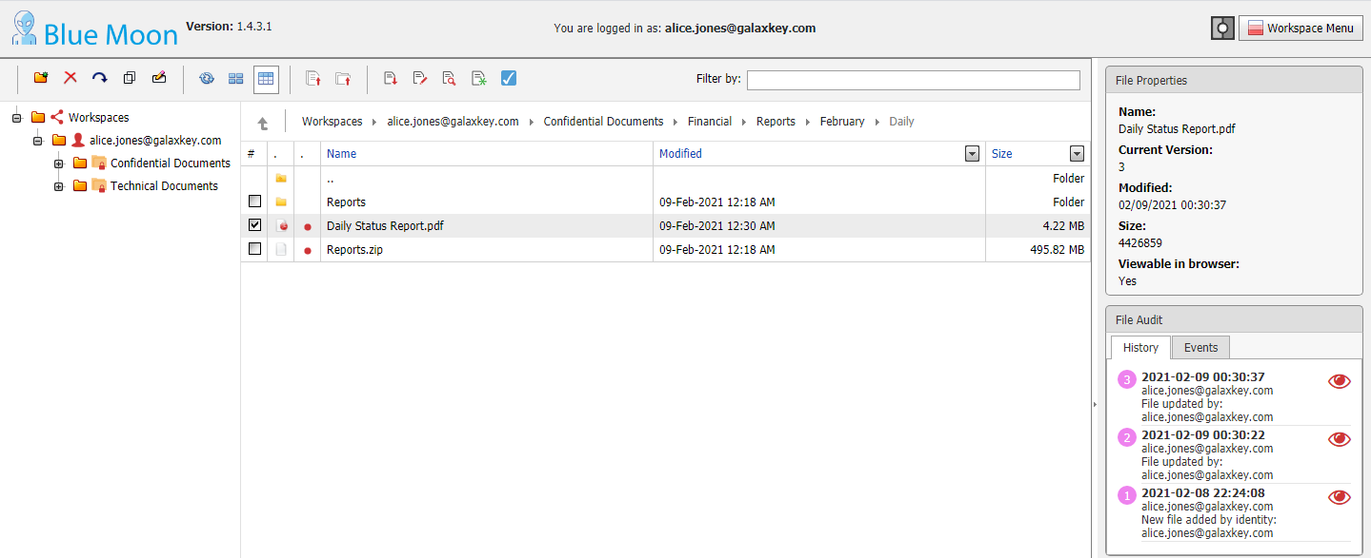
File Versioning
File Versioning
The version of the file is incremented in one of the following events:
File opened in edit mode by one or more members
Another file with same name is uploaded to the folder
As per your corporate configuration, a fixed number of older versions are stored for future access
View Version Details
The right-hand properties pane displays a detailed audit of the version changes under two tabs
Events
History: You can access a file of one of the previous versions using the view option
 | The workspace action menu and the properties vary according to the logged in users’ access rights. The owner views all the options, based on the corporate policies.

Slide 20
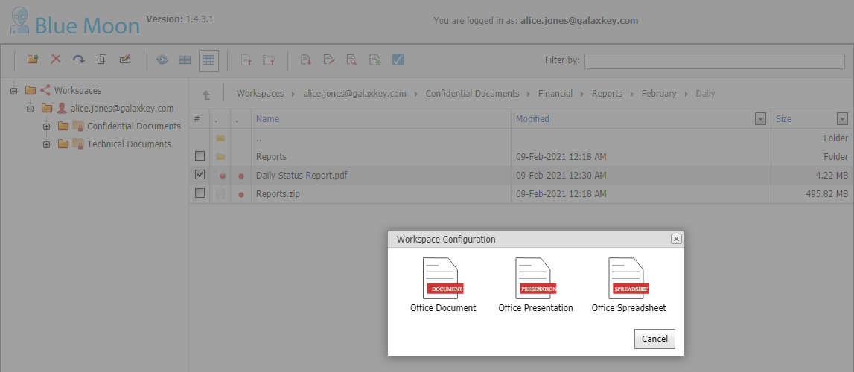
Creating Files
Creating Files online
Click the ‘Create file’ menu option from the top menu-bar or the context menu
Select one of the three types of files – Word (.docx), Excel (.xlsx) and powerpoint (.pptx)
After adding the required content to the file, use the close button to return to the workspace listing.
Rename Files
The files created online are created as ‘New <Document>’
Select the file and click the Rename menu option to edit the file name

Slide 21
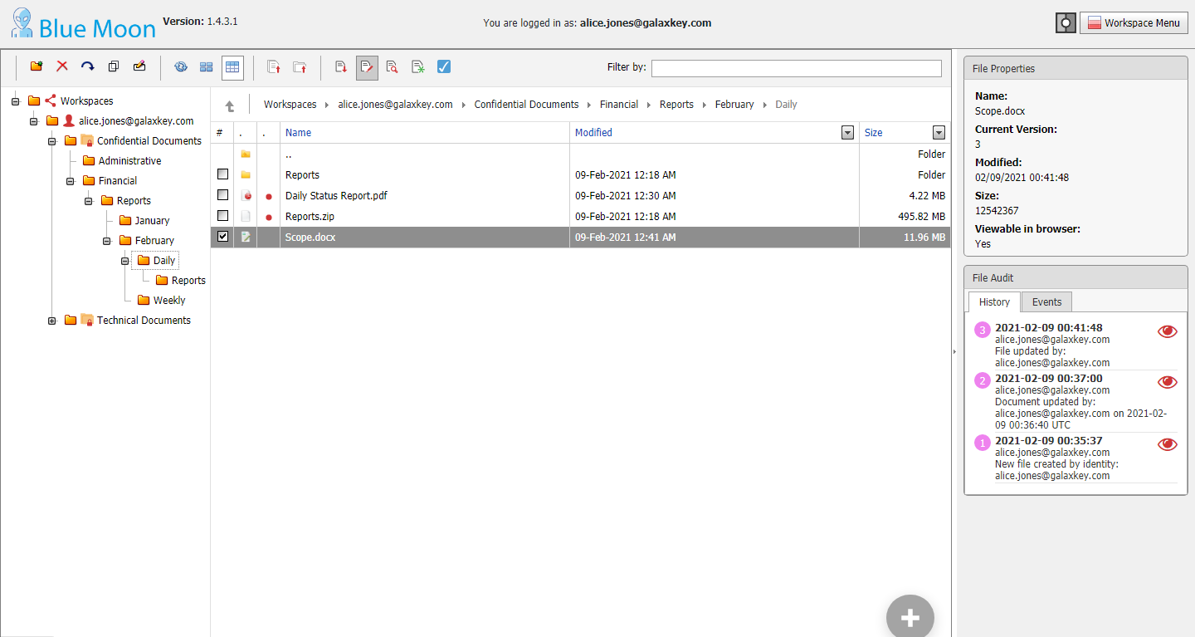
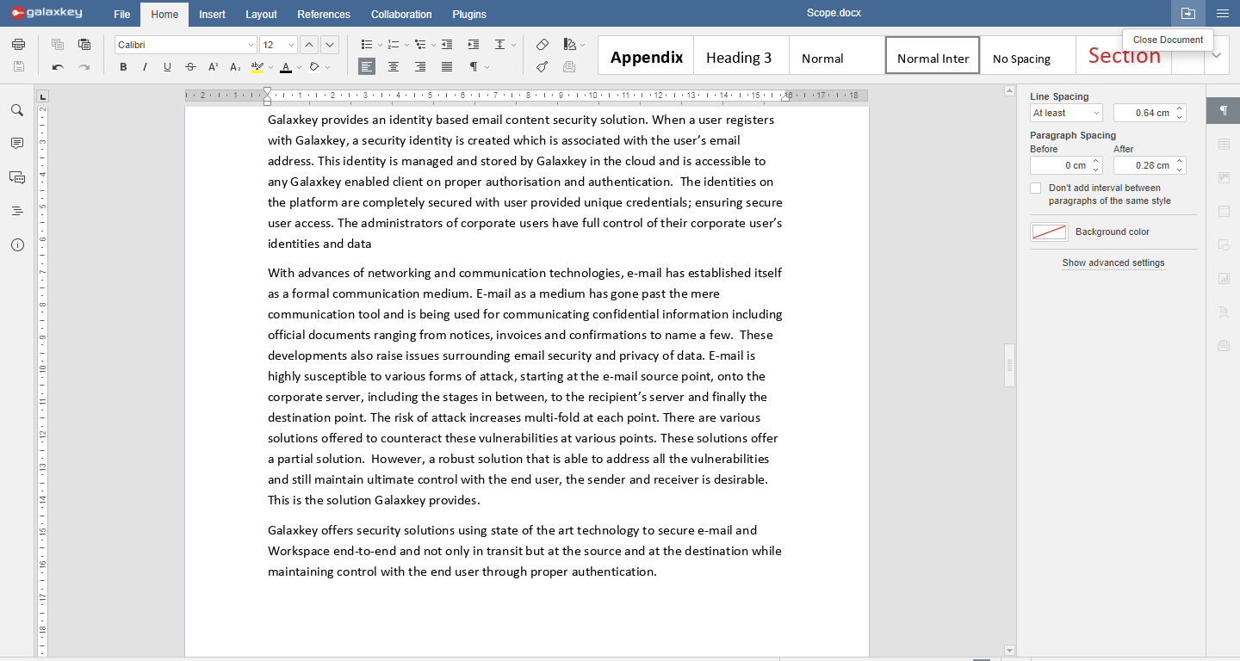
Edit Files
You can edit office files (.docx, .xlsx or .pptx) online using the Galaxkey Collaboration feature
Files created on the workspace and uploaded; both can be edited online
To open a file in edit mode;
Double click the file
Select the file and click Edit option in the menu bar or context menu
Galaxkey allows simultaneous editing by more than one member.
Both members have the visibility to the changes

